Slide 1


Forest Fire Detection using DL

Slide 2

Learning Objectives
Understand how to preprocess and classify image data using CNN.
Build a wildfire detection model using deep learning.
Deploy a user-friendly web interface using Streamlit.
Visualize predictions for real-time image input.
GOAL
Source :
www.freepik.com/

Slide 3
Tools and Technology used
Languages: Python
Libraries : TensorFlow, Keras, NumPy, OpenCV, Matplotlib, PIL, os
Framework: Streamlit (for GUI)
Platform : Jupyter Notebook, CoLab , Kaggle

Slide 4
Methodology
Data Preprocessing: Resize, normalize, and split dataset.
Model Architecture: Build a Convolutional Neural Network (CNN) with Dense layers.
Training: Use labeled images to train the model with accuracy tracking.
Evaluation: Validate with test data and visualize performance.
Deployment: Design a responsive GUI using Streamlit.

Slide 5
Problem Statement:
Wildfires cause massive environmental and economic damage. Manual detection is slow and resource-intensive, leading to delayed responses.

Slide 6
Solution:
Develop a deep learning model that classifies images into “Wildfire” or “No Wildfire”, integrated into an interactive web app that allows users to upload images and receive instant predictions.

Slide 7
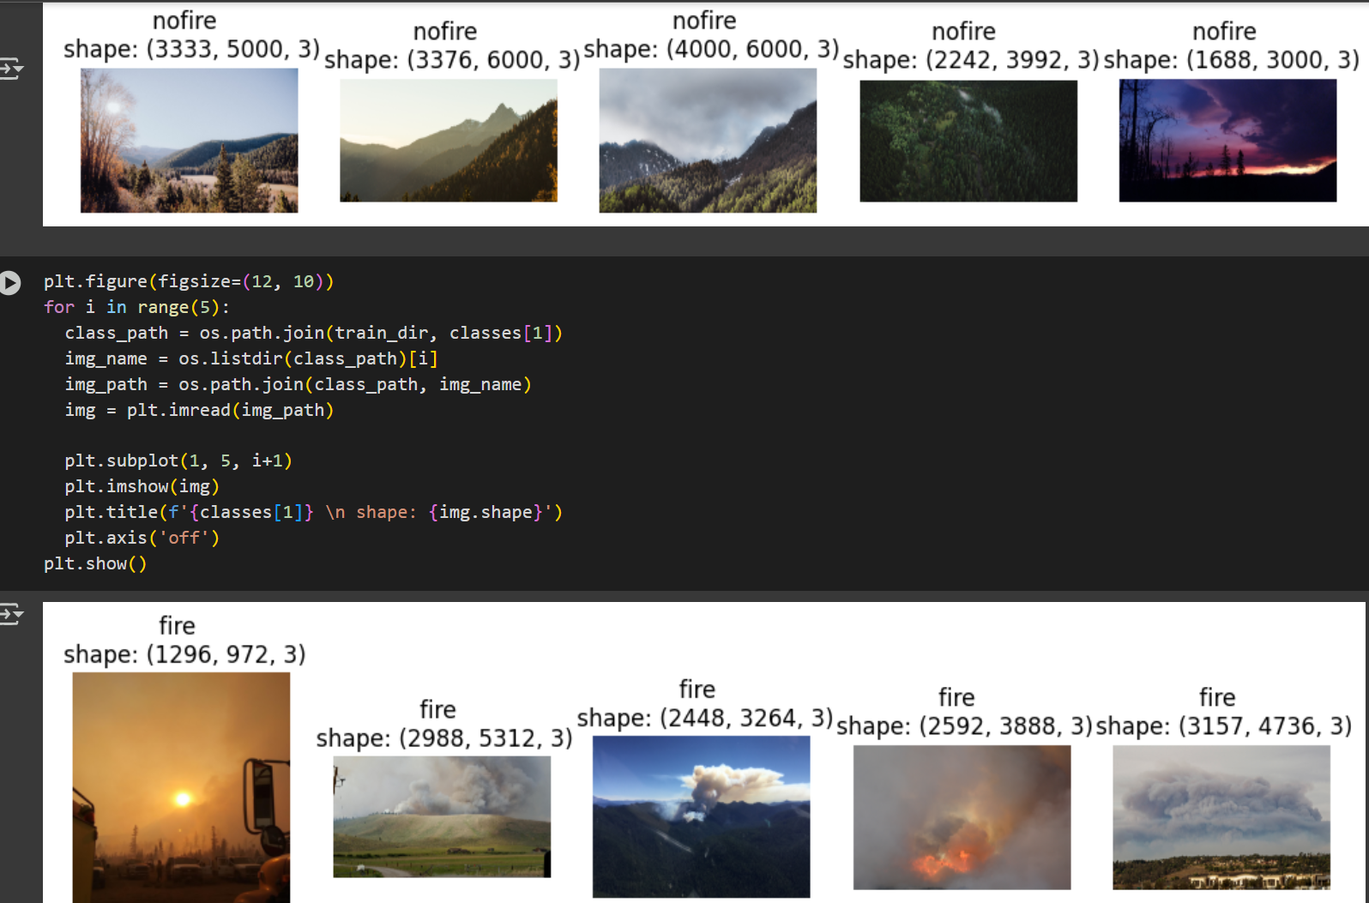
Screenshot of Output:

Slide 8
Conclusion:
Therefore built and deployed a wildfire image classifier with high accuracy and an intuitive interface. This tool can assist in early wildfire detection and support disaster response systems.

